Slide 1
CG1112
Tutorial 2

Slide 2
Question Assignment
Room 1 – Q1
Room 2 – Q2
Room 3 – Q3
Room 4 – Q4
Room 5 – Q5
Room 6 – Q6
Room 7 – Q7
Room 8 – Q8

Slide 3
Part 1
GPIO

Slide 4
Q1. Understanding GPIO Options
In the studio we have used PORT B pins for the LED’s and Switches.
PB7 and PB6 are currently mapped to the external crystal oscillator (XTAL1 and XTAL2 for the Uno Board).
You have decided to create your own board using the Atmega328p and want to make use of all 8-bits of PORTB.
Is it possible?
What are the factors to consider?

Slide 5
Q1. Understanding GPIO Options
Referring to Table 13-1, it can be seen that there are different clocking options available for the 328p.
Two of those options refer to the ability to use an internal clock. By selecting those options we can free up PB7 and PB6 to be used as GPIO.

Slide 6
Q1. Understanding GPIO Options
The most important factor to consider is that when we use an external clock, we have a wide range of frequencies to choose from. Once we switch to an internal clock, we are limited by what the device provides. We need to check and see if what is provided is sufficient for our needs.
Internal 128KHz RC Oscillator: 128khz
Calibrated Internal RC Oscillator: 8MHz
Will these frequency settings satisfy your project requirements?

Slide 7
Q1. Understanding GPIO Options
More Discussion Points
What are the factors to consider when choosing the Frequency?
Meeting Timing Constraints
Power Consumption
Stability
What are the implications to the code?
- Calculated values for timing related features like ADC Sampling, Timers, etc.

Slide 8
Q2. GPIO Configuration
In our studio we configured LED’s in “Active-High” logic, i.e. we applied a Logic ‘1’ to Turn it ‘ON’ and a Logic ‘0’ to turn it ‘OFF’.
Draw a circuit connection to connect an LED in “Active-Low” logic to PORTB Pin 1, i.e. you need to apply a Logic ‘0’ to turn it ‘ON’ and a Logic ‘1’ to turn it ‘OFF’.
Vcc (+5V)
PB1
Resistor

Slide 9
Q2. GPIO Configuration
Write the code to set the DDRB register value according to your schematic.
It is still an O/P because we are writing a value to the pin.
DDRB |= 0b00000010; // Set Bit 1 to output by OR with ‘1’.

Slide 10
Q2. GPIO Configuration
In a design such as this, we say that the microcontroller is “sinking” current. That means, that current is now flowing into the pin of the device. What’s the maximum sinking current when the device is operating at 5V?
Answer: 20mA (Refer to Table 32-2 in the Atmega328p datasheet)
What does Note 4 inform us?

Slide 11
Q2. GPIO Configuration
Important to note that there is a maximum limit on the total amount of current that the various pins can collectively sink.

Slide 12
Q2. GPIO Configuration
The voltage drop across the LED is 0.7V. Choose an appropriate R value.
R >= (5 – 0.7) / 20 mA = 215 ohms
The minimum value of R is 215 ohms.

Slide 13
Further Discussion on GPIO
How much is the source current when you set the output to ‘1’?
20mA. The absolute maximum is 40mA.
Is that enough?
Depends on the application. If you are controlling an LED, then it should be. If you are trying to interface to a Motor, then it may not be enough.

Slide 14
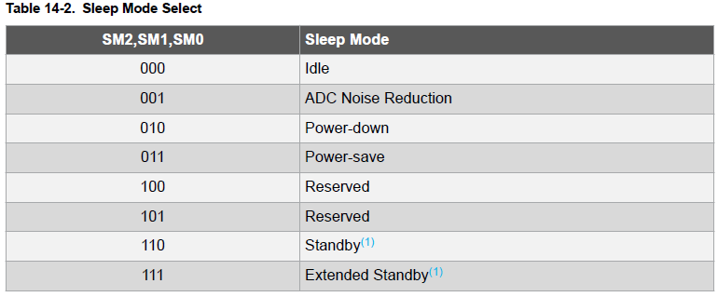
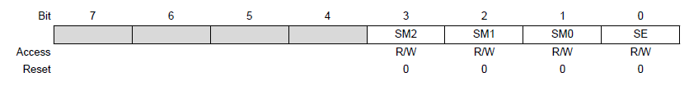
Q3. Power Consumption
Power Consumption is a critical factor in Embedded Systems and it is important to minimize it so as to extend its usage before recharging the batteries. You wish to put the robot in “Standby Mode” when it is idle and not doing anything useful.
Which is the main register that controls these features and what value should be written to it?
The Sleep Mode Control Register (SMCR) contains the control bits for power management. To put the device in Standby Mode, a value of 110 must be written to it bits SM2:SM0 (Bits 3:1).

Slide 15
Q3. Power Consumption
In Standby Mode, which events can trigger the device to “wake-up” and resume full-functionality?
Only one of these events can wake up the MCU:
• External Reset
• Watchdog System Reset
• Watchdog Interrupt
• Brown-out Reset
• 2-wire Serial Interface address match
• External level interrupt on INT
• Pin change interrupt
How many clock cycles does it take for the device to come out of Standby mode to full operation?
It takes 6 clock cycles.

Slide 16
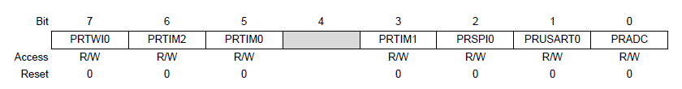

Q3. Power Consumption
Based on your initial assessment, you feel that you may not need to use the ADC module for this project. As such, you want to disable it so that it doesn’t consume any additional power. How can this be achieved?
The Power Reduction Register (PRR) provides a method to stop the clock to individual peripherals to reduce power consumption.

Slide 17
Further Discussion on Power Consumption
Battery Life / Electricity Bill
Challenges in meeting Certification Standards
e.g. https://www.energystar.gov/
Some countries are very strict about energy-efficient products. If the standards are not met, you will not be able to sell your product in that country.
Key Takeaway: Energy Consumption is dependent on the entire system. The microcontroller is just one component in it. You need to have a System-Level understanding to minimize Power Consumption in all areas.

Slide 18
Part 2
Interrupts

Slide 19
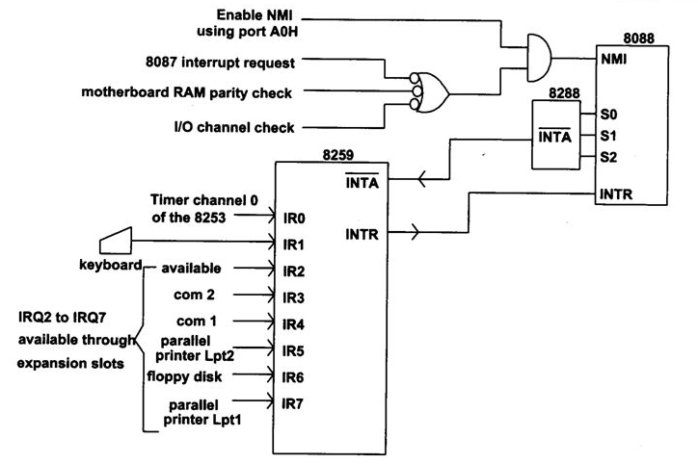
Q4. HW Interrupts
What are hardware interrupts? Why are they needed? Give some examples of hardware interrupts in your laptop or PC.
A hardware interrupt consists of a series of request lines built into the CPU or MCU. Its purpose is to let hardware signal to the CPU to get its attention.

Slide 20
Q4. HW Interrupts
The CPU can be busy running code, but when an interrupt request line is triggered (either by a rising edge, falling edge or change in signal level), the CPU stops what it is doing, and runs a special piece of code called an Interrupt Service Routine (ISR) to handle the interrupt. Once the ISR is complete, the CPU resumes what it was doing, from where it left off.
Examples on a PC or laptop include interrupts from the keyboard when someone has pressed a key, or from the network interface when a frame of data has come in over the network, etc.

Slide 21
Q4. Software Interrupts
A software interrupt is an interrupt that is triggered using a special machine instruction, rather than a hardware line.
Intel machines, for example, use the INT command to trigger software interrupts:
INT <interrupt number>
Here <interrupt number> is an interrupt identification number (analogous to the interrupt request lines in hardware interrupts), ranging from 0 to 255.

Slide 22
Q4. Software Interrupts
Like hardware interrupts, software interrupts cause the CPU to jump to an ISR, with a different ISR for each of the 256 possible software interrupts.
The address of each ISR is flexible and the CPU can be configured to jump to the correct ISR.
Software interrupts are very useful for providing flexible entry points for software APIs (application programming interfaces).
For example, on the LINUX operating system, if a program wishes to make a request to the OS (e.g. to write to the screen), it can do this by executing INT 128 (INT 80h, in hexadecimal).

Slide 23
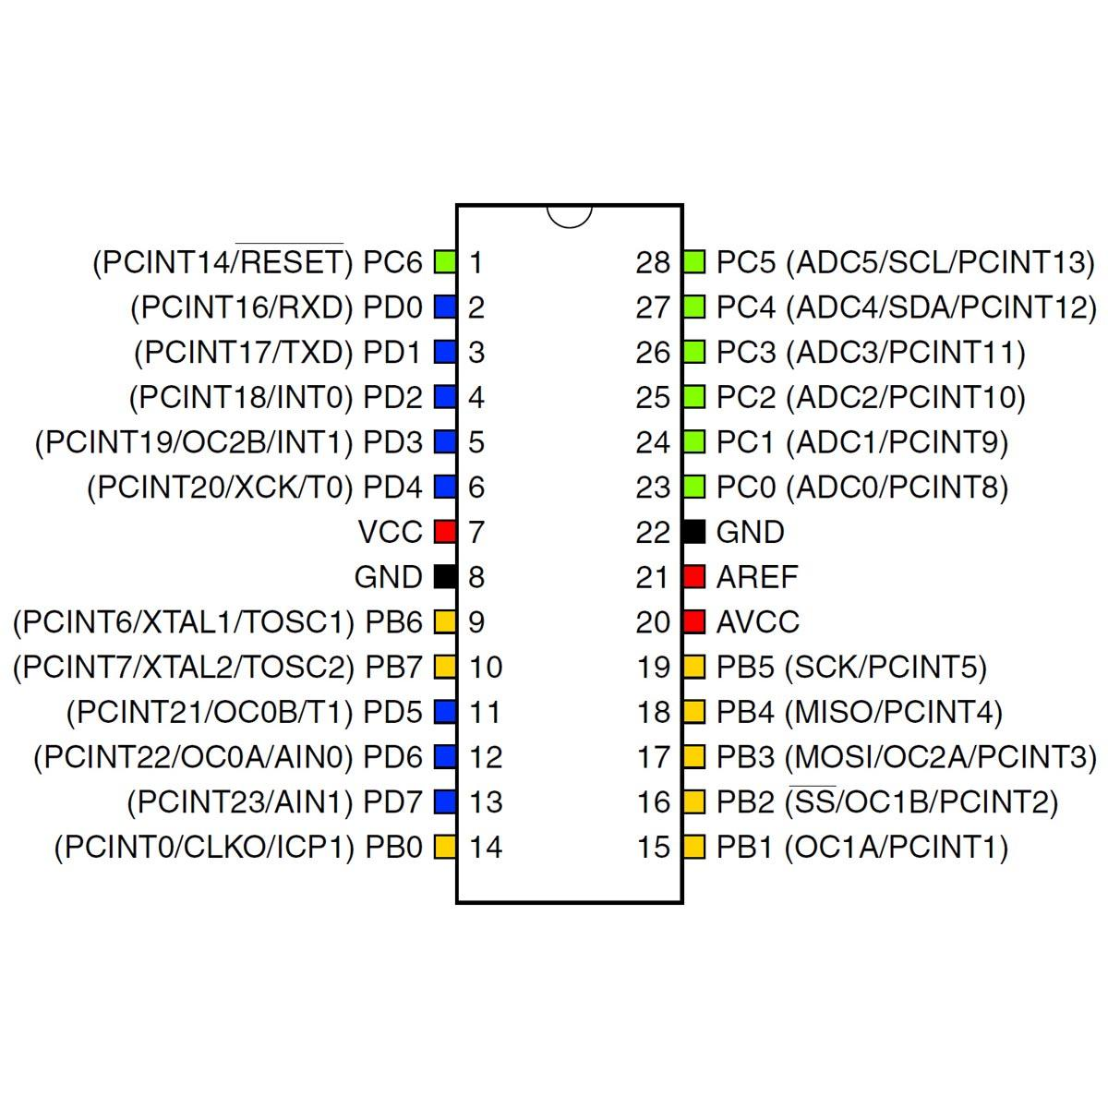
Q5. Interrupts on the AT328P
What interrupt request lines are available on the Atmega328P? Describe these lines and how they are used.
There are two main types of interrupt request lines:
Two external interrupt lines
INT0 and INT1 (PD2 and PD3)
23 “pin change” interrupt request lines PCINT0 to PCINT23 (note: No PCINT15).

Slide 24
Q5. Interrupts on the AT328P
INT0 and INT1 are much more flexible. They can be triggered by:
A low signal level
A change in signal level
Rising edge
Falling edge

Slide 25
Q5. Interrupts on the AT328P
In addition INT0 and INT1 each have their own ISR.

Slide 26
Q5. Interrupts on the AT328P
The pin change interrupt requests (PCINT0 to PCINT23) only respond to changes in voltage levels.
In addition, the 23 PCINT lines are grouped into 2 groups of 8 lines each and one group of 7 lines.
All lines in the same group will trigger the execution of the same ISR. I.e. there are only 3 unique ISRs even though there are 23 lines.

Slide 27
Q6. Handling Interrupts - Context Switching
Every interrupt request line is assigned an index number.
The CPU tests the state of the interrupt request lines many times a second. (On the MIPS range of microprocessors, for example, the CPU tests the lines at the end of each instruction execution).
When one line is detected to have been triggered, the CPU takes note of its index number.
The CPU consults a table called the Interrupt Vector Table using the index number of the triggered line. This table tells the CPU where the ISR for this particular line is.

Slide 28
Q5. Handling Interrupts - Context Switching
The CPU saves the contents of the Program Counter (PC) onto the “process stack” – a data structure similar to what you have learnt in CS2040C, which tells the CPU where to get the next program instruction for execution.
The CPU loads the address of the ISR into PC, causing it to execute the ISR code.
The ISR ends with a Return from Interrupt (RETI) instruction, that causes the CPU pop the stack containing the previous PC value into PC. This causes execution to resume at the point of interruption.

Slide 29
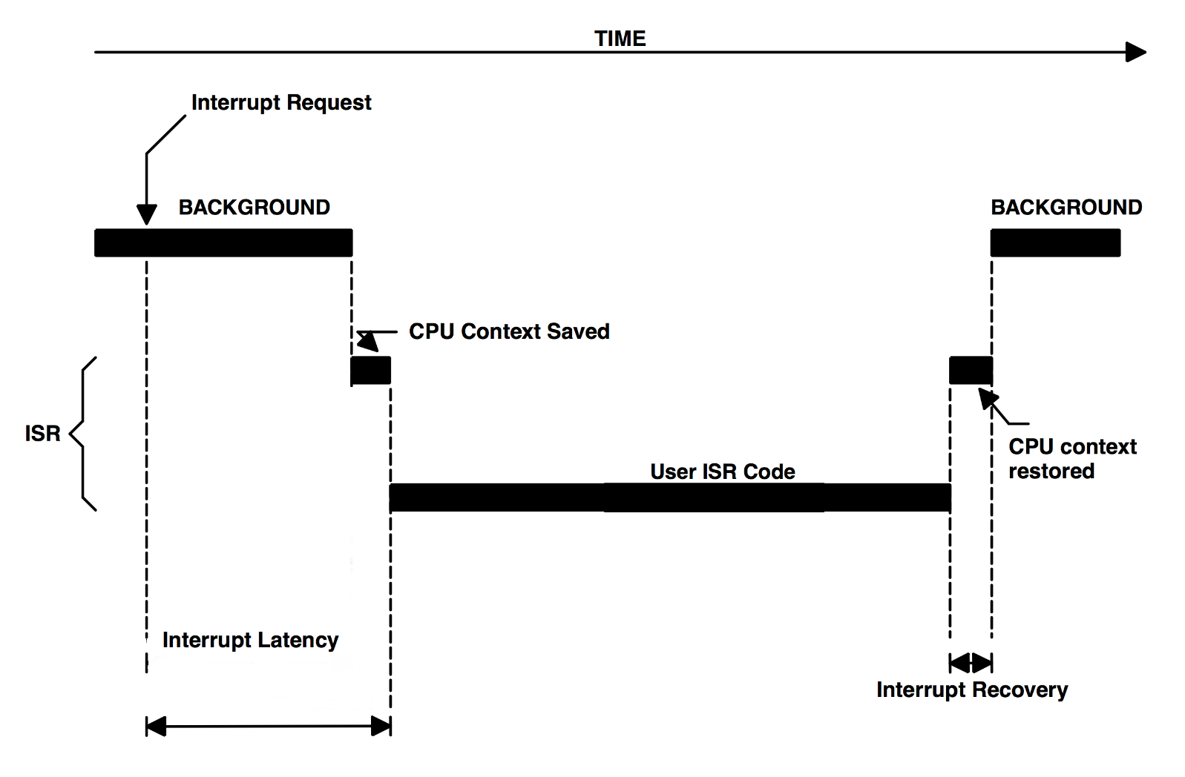
Q5. Handling Interrupts - Context Switching

Slide 30
Q5. Nested Interrupts
What if an interrupt occurs while processing another interrupt?
Interrupts have priority levels.
If the new interrupt has a lower priority than the current interrupt, it is ignored until processing for the current interrupt completes.
If the new interrupt has a higher priority than the current one, PC is again saved on the process stack, and the vector for the new interrupt is loaded into PC, causing it to execute the new ISR.
When the new interrupt exits, PC is popped off the stack, causing the previous ISR to resume.

Slide 31
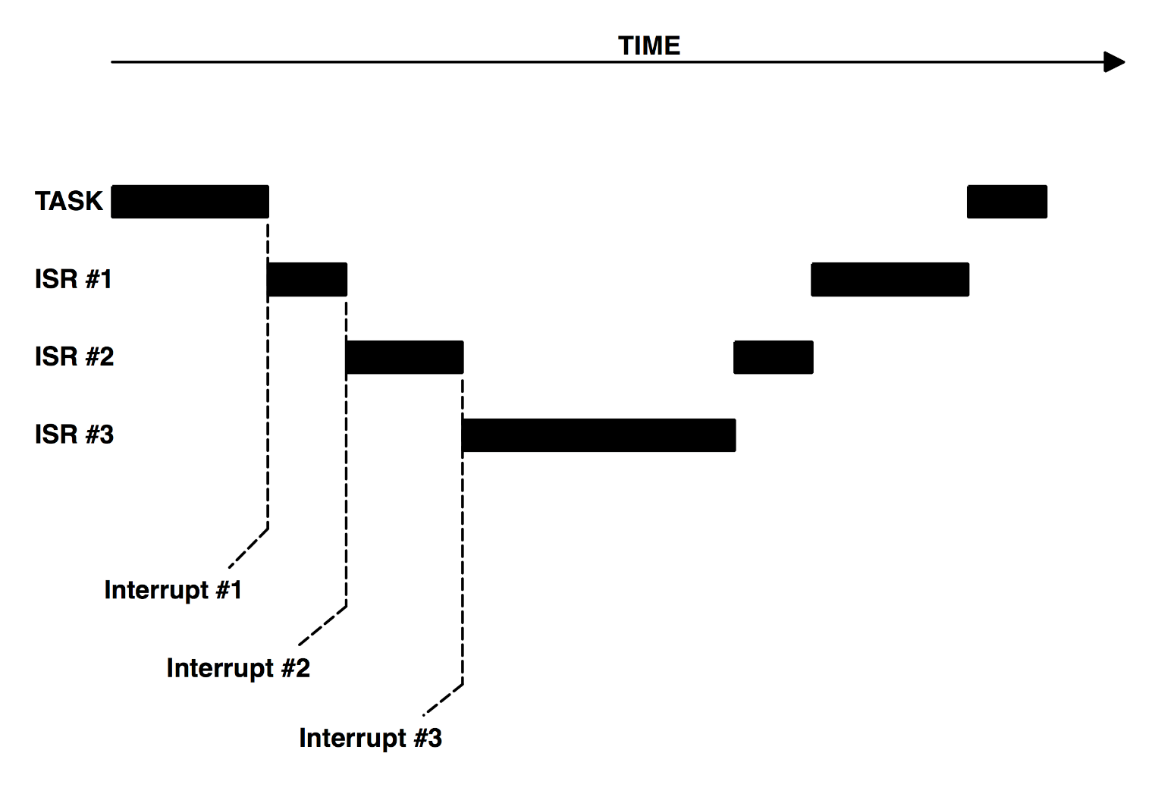
Q5. Nested Interrupts

Slide 32
Part 3
PWM

Slide 33
Q7. Understanding the PWM Module
a) We saw that the AT328p has 3 Timers capable of generating 6 individual PWM signals. Consider the following scenarios and describe how you will be able to resolve the challenges.
Describe a SW approach to generate a PWM signal that is not dependent on the HW PWM peripheral block within the microcontroller.

Slide 34
Q7. Understanding the PWM Module
In the SW approach, we need to manually keep toggling the output pin based on the ON and OFF time for the required Duty-Cycle.
Pseudo-Code:
Configure Pin as output
Set as ‘1’
Delay for ‘T-on’
Set as ‘0’
Delay for ‘T-off’
Loop to Step 2.

Slide 35
Q7. Understanding the PWM Module
What is the drawback of generating the PWM using this approach?
With this approach, the microcontroller is continuously executing the loop to generate the required PWM. As such, it cant do anything else more productive. Furthermore, if there are interrupts in the system, the timing characteristics for the PWM will also be affected.
When the peripheral block is used to generate the PWM, only the initial setup code needs to be executed. Subsequently, it is driven by the HW with minimal processing time in the Interrupts.

Slide 36
Q7. Understanding the PWM Module
b) The microcontroller that you have to use for a particular project (not the AT328p) doesn’t have any PWM module. How can you still generate a PWM signal WITHOUT relying on the software-based approach that you did in Part A? (Recall HW-based solutions from EPP1)

Slide 37
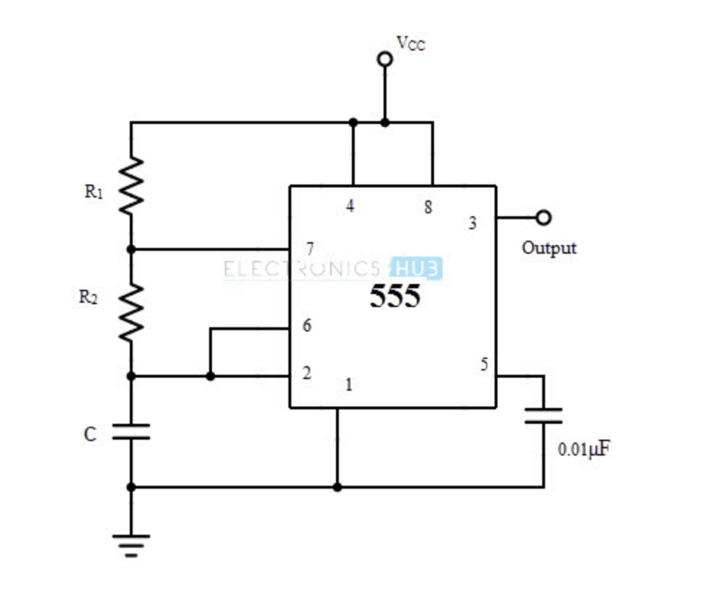
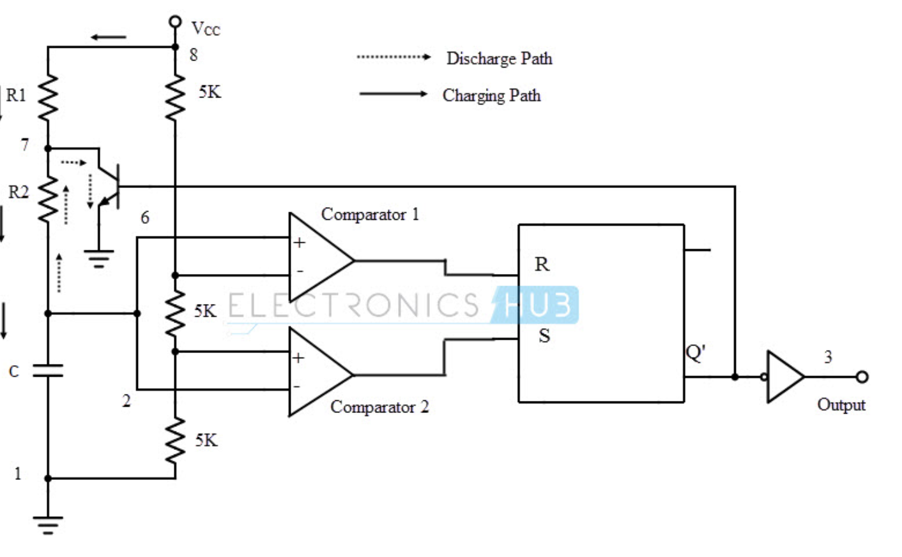
Q7. Understanding the PWM Module
One possible approach is to use the 555 Timer to generate the required PWM signal. The PWM and the Duty Cycle can be varied by adjusting the RA and RB value of the circuit.

Slide 38
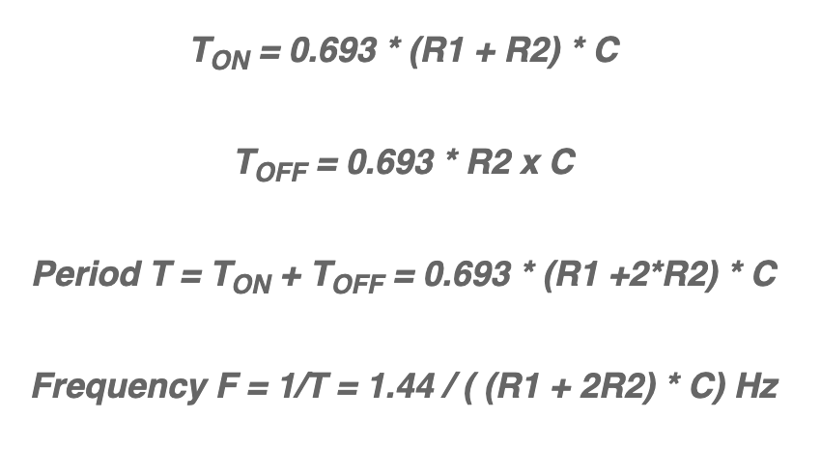
Q7. Understanding the PWM Module
* You have learnt this in EPP1. You can refer to Week6 Studio1 from EPP1 to refresh your memory.

Slide 39
Q7. Understanding the PWM Module
c) You feel that the approach in the earlier part is going to add additional cost to your project and you decide to stick with the AT328P. You require a very low-frequency PWM signal and even with the largest pre-scaler setting, the period is still too high. How will you be able to generate a PWM signal with the required period?
Propose at least TWO different approaches that can involve both HW and SW.

Slide 40
Q7. Understanding the PWM Module
Option A:
Another software approach would be to use the ISR to keep track of the number of Interrupts and then toggle the output pin accordingly. In this approach, we cannot allow the PWM block to control the pin directly. The ISR needs to handle it.

Slide 41
Q7. Understanding the PWM Module
Option B:
Consider using a higher-bit timer. In the AT328P, we have Timer 1, which is a 16-bit timer/counter.

Slide 42
Q8. Timer Interrupts
In the studio, you were driving a single motor. If we were to drive both Motors concurrently, one possibility is to use both Timer 0 and 2.
Assume that both Timer blocks are configured to use Interrupts and that the microcontroller was executing code in your loop() routine prior to the interrupts.

Slide 43
Q8. Timer Interrupts
a) If both these interrupts were to be triggered at the same time, what would be the sequence of execution?
Main()
Timer 2 ISR
Timer 0 ISR
Main()
Context Switch
Recall: Interrupt Priority

Slide 44
Q8. Timer Interrupts
b) If Timer 0 triggered the interrupt just before Timer 2, what would be the sequence of execution?
Main()
Timer 0 ISR
Timer 2 ISR
Main()
By default, Nested Interrupts are disabled. When Timer 0 triggers the interrupt first, the controller will jump to Timer 0 ISR and start executing. When Timer 2 triggers, the event is captured by the flag, but the current ISR will complete execution and perform a context switch to the loop(). At this time, the flag will cause the jump to the Timer 2 ISR.

Slide 45
Q8. Timer Interrupts
What if nested interrupts were enabled?
Main()
Timer 0 ISR
Timer 2 ISR
Timer 0 ISR
Main()
T0 ISR resumes
T0 ISR pre-empted by T2

Slide 46
The End!
Q & A

